Slide 1
FOOD supply Chain Management
Transforming the Global Food Supply Chain
Through Innovative Data Solutions

Slide 2
OUR Mission
Create a robust web application that revolutionizes the management of the global food supply chain. By harnessing innovative technologies, we aim to streamline data storage and tracking processes, ensuring transparency, efficiency, and sustainability throughout the entire food distribution network. Through this platform, we aspire to empower stakeholders to make informed decisions, optimize logistics, minimize waste, and ultimately contribute to a more resilient and accessible global food system.

Slide 3
SUMMARY
A web application to store and track data on the global food supply chain has the potential to improve increase efficiency and transparency in the food supply chain. The application can be used by a variety of stakeholders, including food producers, processors, distributors, retailers, and consumers. The project is currently in the planning phase, and the next steps are to secure funding and begin development.

Slide 4
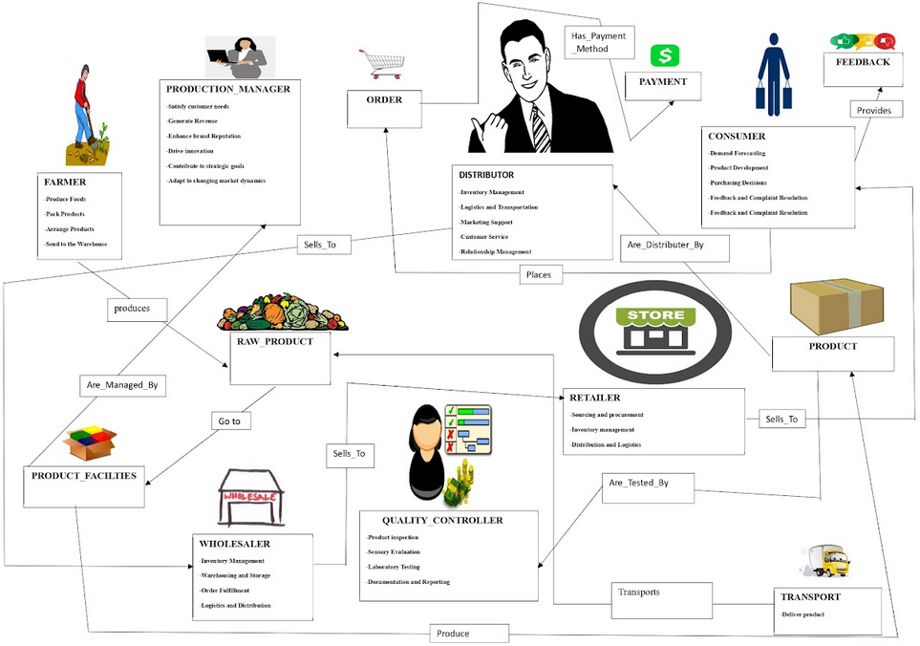
Rich Picture of Existing System

Slide 5
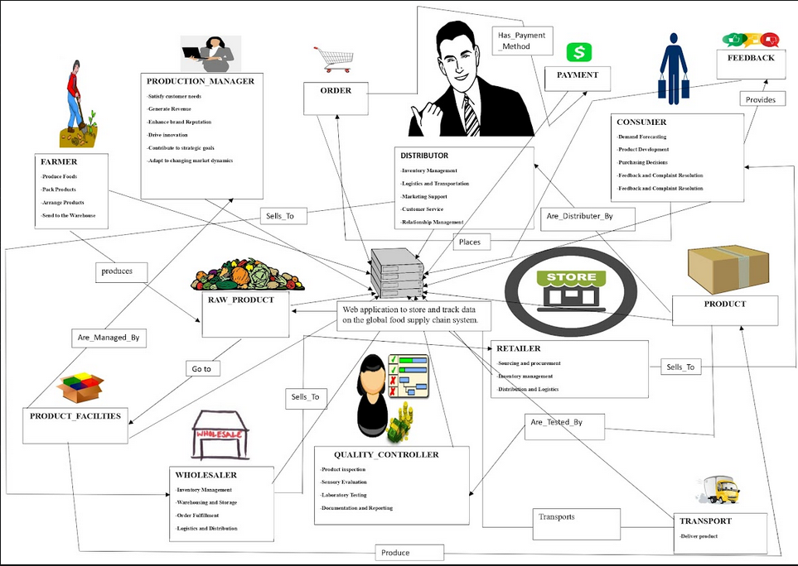
Rich Picture of Proposed System

Slide 6
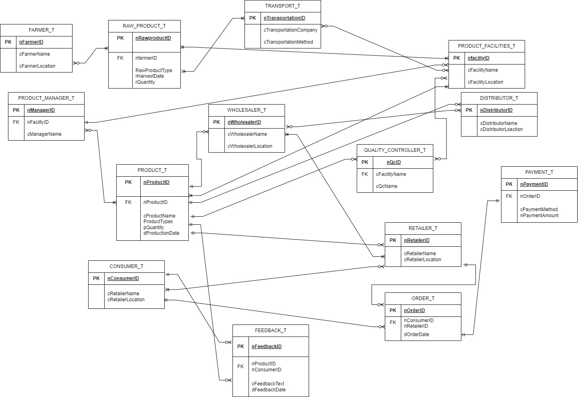
Entity Relation
Diagram

Slide 7
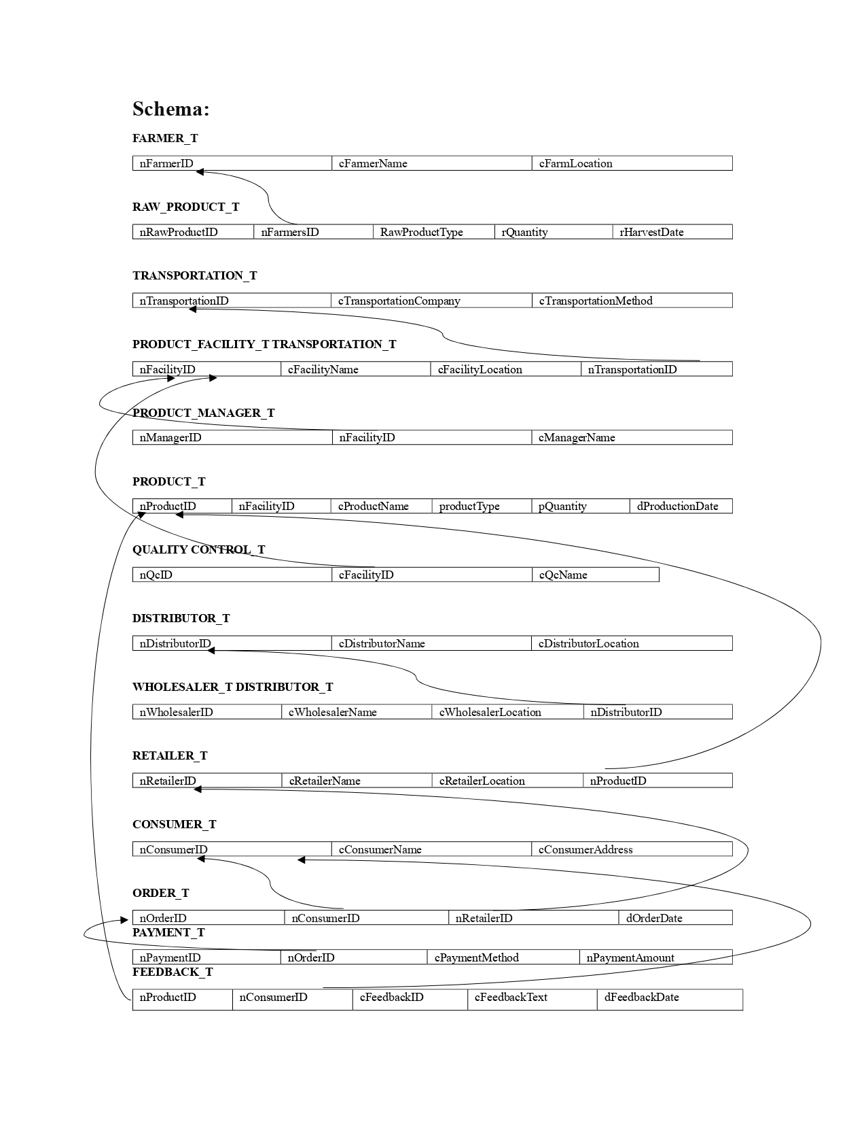
Relation
Schema

Slide 8
Normalization

Slide 9
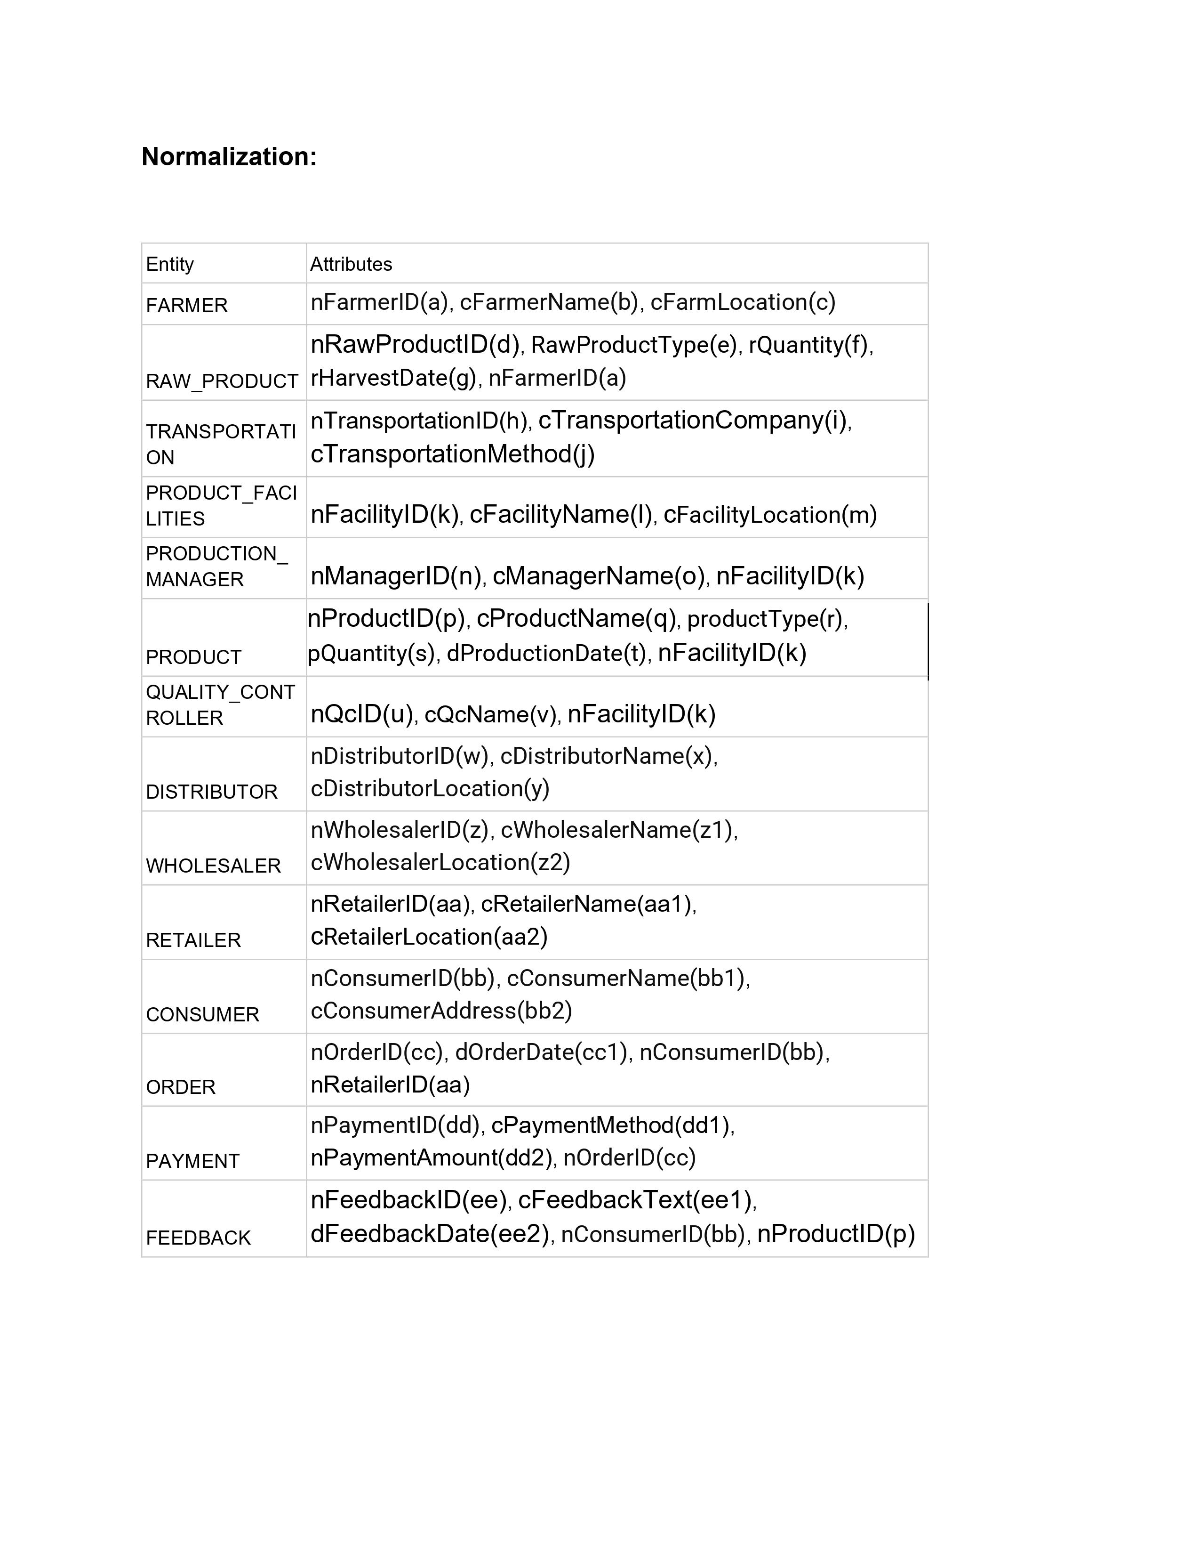
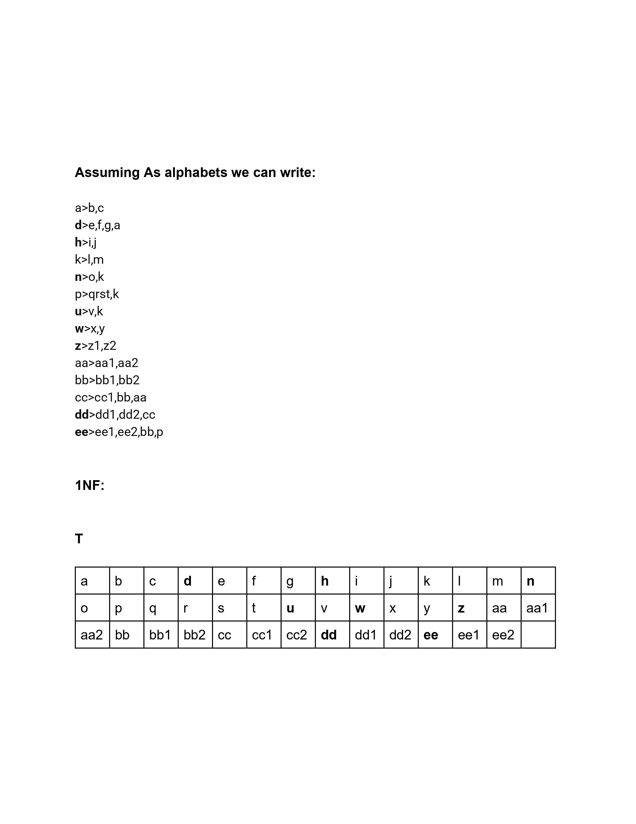

Slide 10
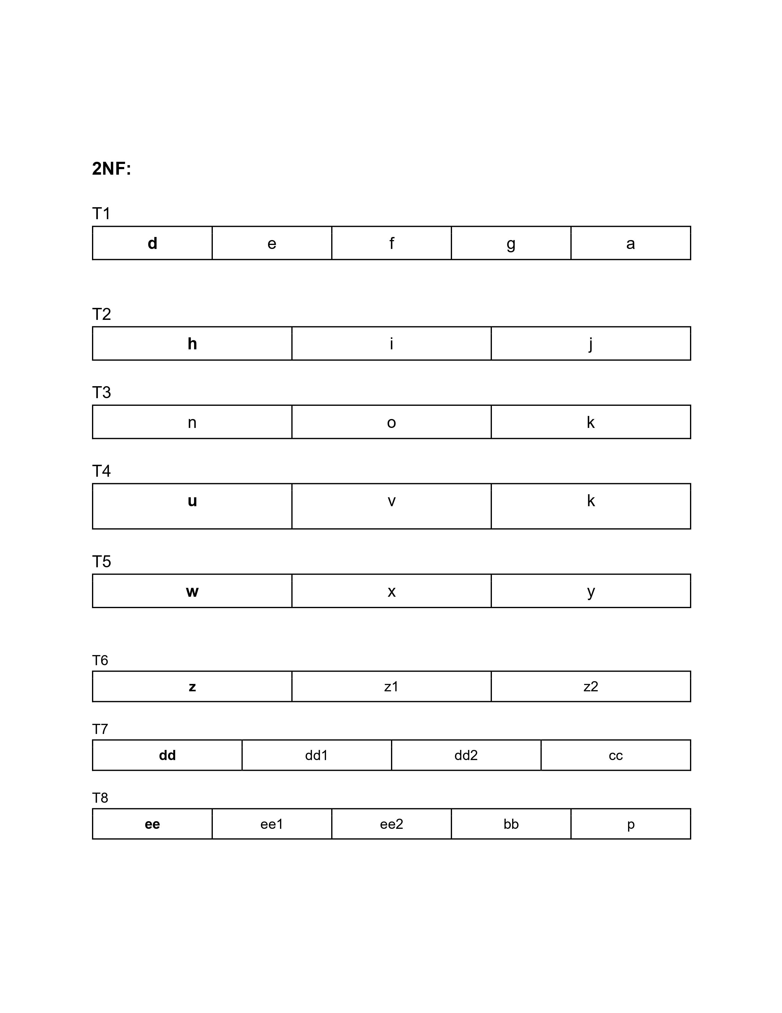
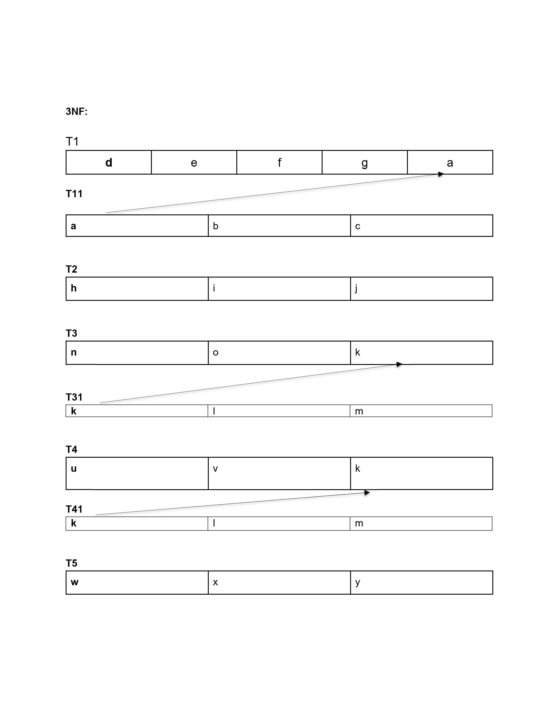

Slide 11
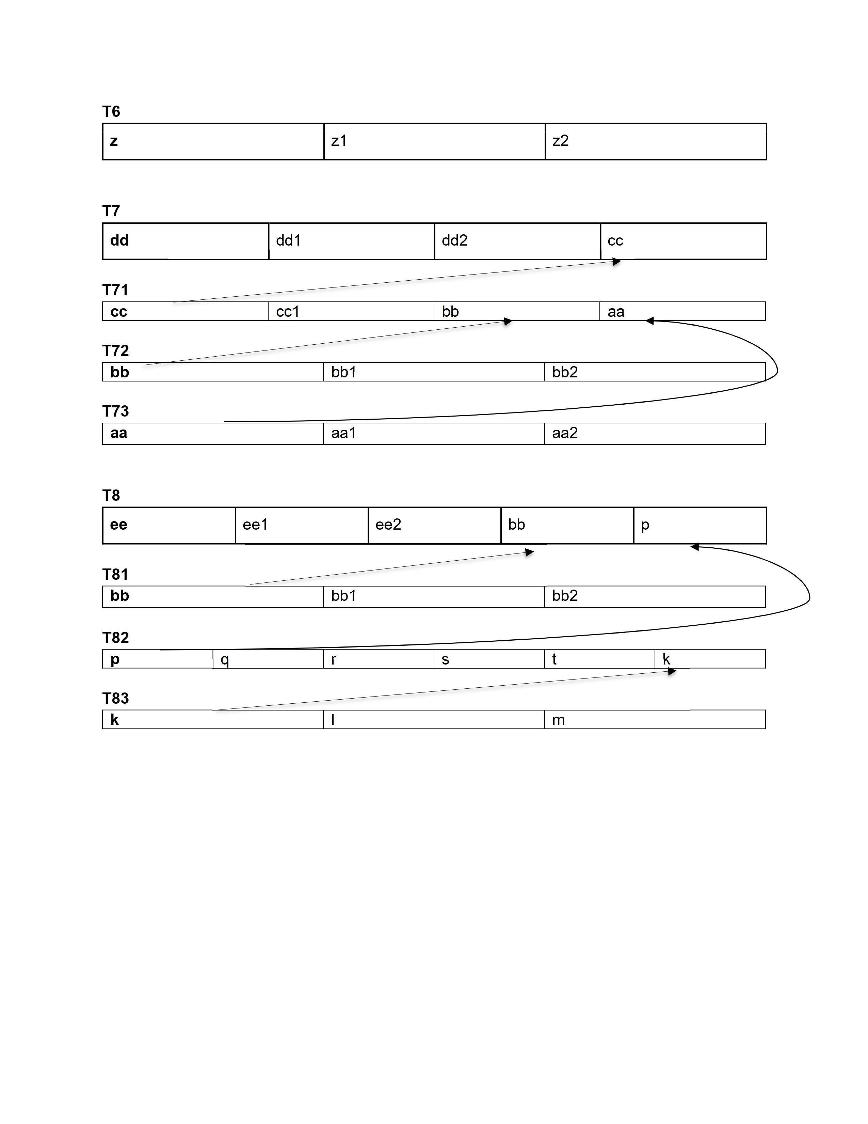

Slide 12
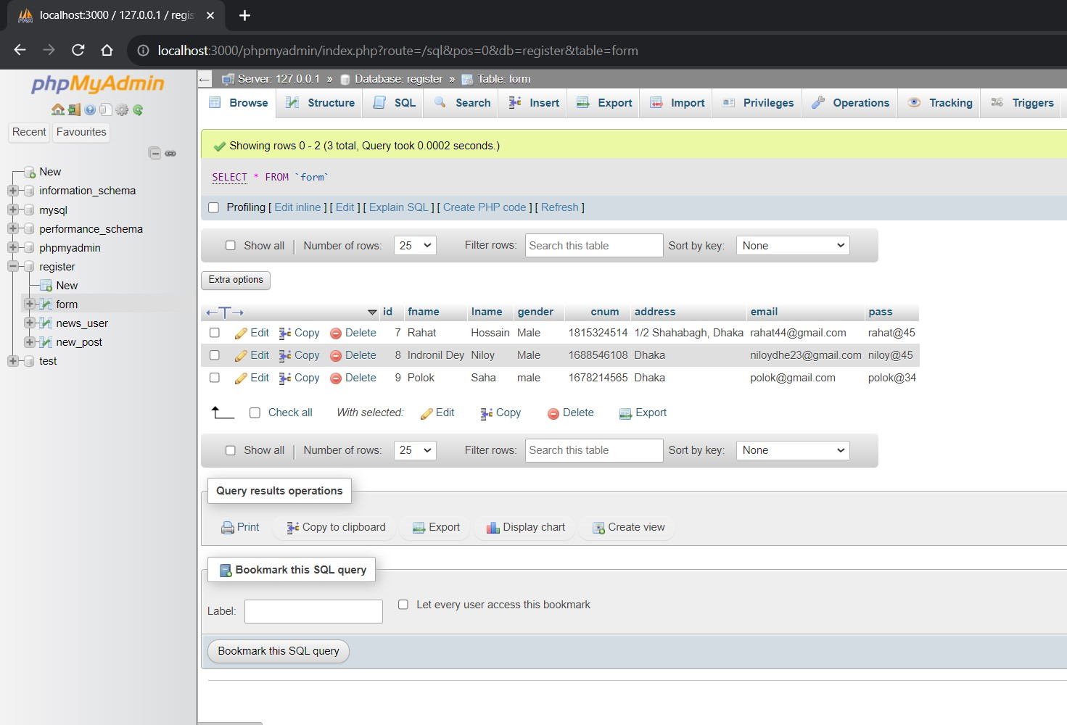
Implemented DAtabase
table

Slide 13
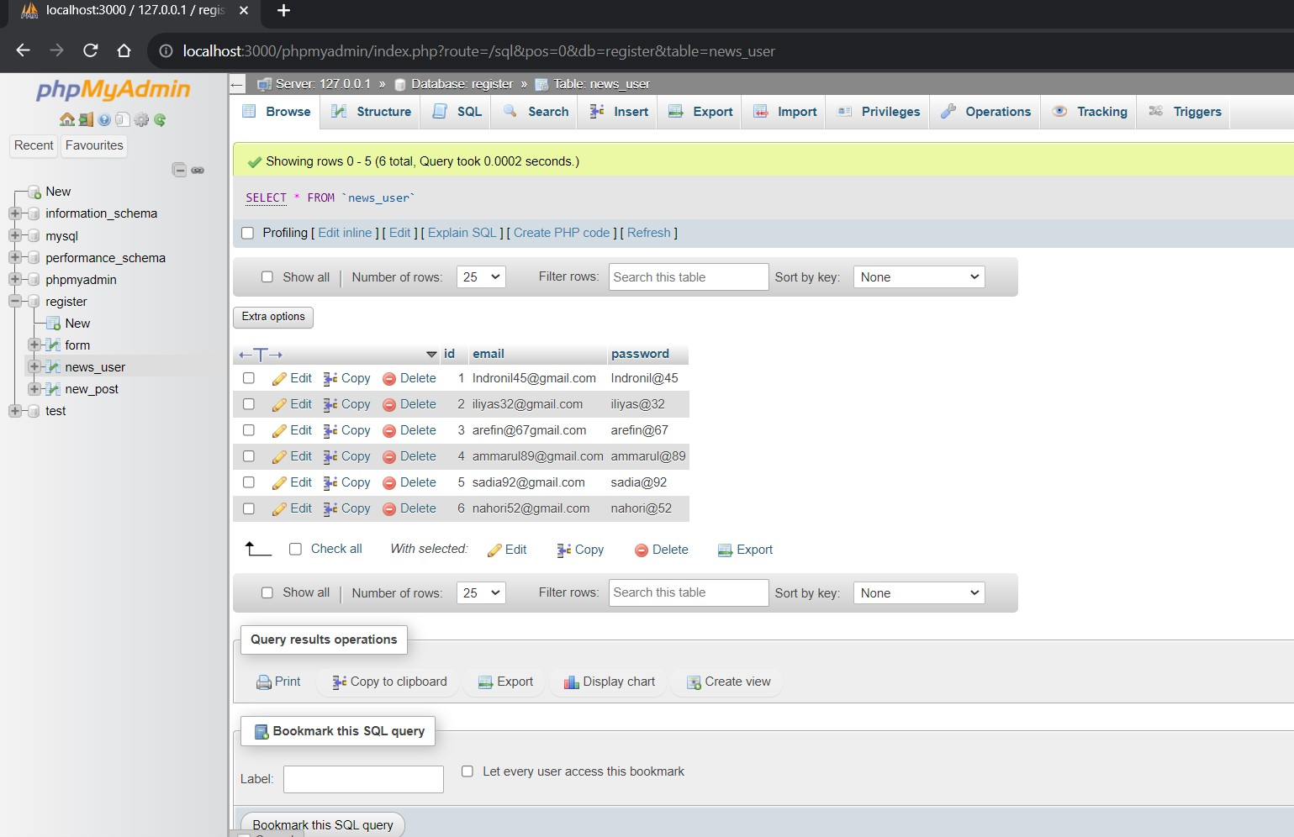

Slide 14
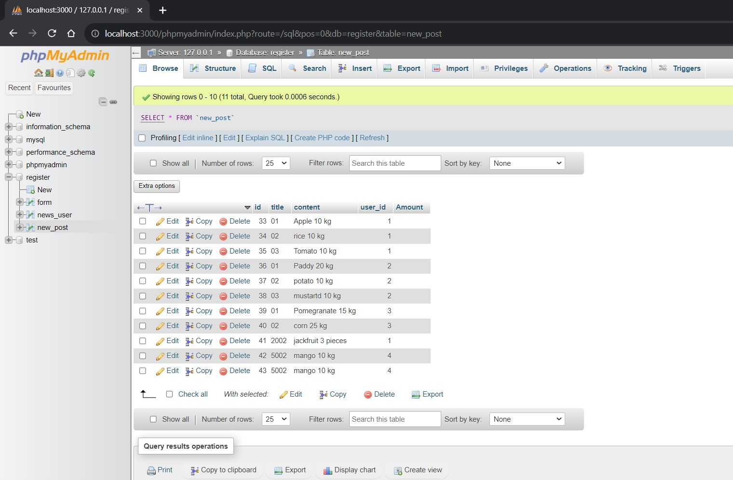

Slide 15






MEET THE TEAM
Nohori Jobaida
Iliyas Ahmed
Indronil Dey Niloy
Sadia Akter
1931154
2020365
2020339
2022719
Syed Shamsul Arefin
Ammarul Islam Anik
1931335
1910594

Slide 16
THANK YOU

